Slide 1

Biomedical Systems—II

Slide 2
Introduction
We will study a couple of biomedical systems apart from the diseases. These systems so developed present another dimension to the infinite possibilities of biomedical systems. At the same time, these systems use the soft computing approach to solve very interesting real-life problems.
We first discuss a system that computes and tells us the nature of pregnancy. Here we solve the same problem using the artificial network (ANN) with back propagation algorithm (BPA), radial basis function network (RBFN), learning vector quantization (LVQ), and finally the adaptive neuro-fuzzy inference system (ANFIS).
We would be discussing about the problem of Pima Indian diabetes. Here we try to identify cases of diabetes from the various attributes. This problem may be solved in a variety of ways. Here we use ANN with BPA, ANFIS, and ensemble and evolutionary ANN.

Slide 3
Hybrid Systems As Classifiers
The hybrid systems are a collection of the basic systems of soft computing. These systems make use of a combination of systems in order to get the added advantages of both systems in use. The disadvantage of one is overcome by the advantage of the other and vice versa.
One of the first systems that we discussed was ANN with BPA. Here we saw that these were the most generalizing networks that tried to generate solutions by the use of global rules.
In any ANN trained with BPA, the complexity of the problem is said to be high if the curve to be imitated has a large number of turns. In classificatory problems, this may be interpreted as meaning the complexity of the problem is very high if the region of the presence of the class intermingles a lot with the region where the class is not found.

Slide 4
Hybrid Systems As Classifiers
A low interclass separation means that the curve to be imitated has its maxima immediately following its minima or vice versa. In other words, if we increase the value of some parameter even by a very mall amount, the class will change. This makes the ANN very sensitive to inputs.
We are given some training data to train the system with. But we do not know its complexity. For this reason, we need to try to train the system again and again in order to get the most optimal ANN architecture. But the resulting system may still not be optimal. Hence there is definitely a problem in the use of ANN.
This limitation restricts the ANN from attaining various impossible structures. Further it limits the search space for the training algorithm, and this may drastically improve performance.

Slide 5
Hybrid Systems As Classifiers
A low interclass separation means that the curve to be imitated has its maxima immediately following its minima or vice versa. In other words, if we increase the value of some parameter even by a very mall amount, the class will change. This makes the ANN very sensitive to inputs.
We are given some training data to train the system with. But we do not know its complexity. For this reason, we need to try to train the system again and again in order to get the most optimal ANN architecture. But the resulting system may still not be optimal. Hence there is definitely a problem in the use of ANN.
This limitation restricts the ANN from attaining various impossible structures. Further it limits the search space for the training algorithm, and this may drastically improve performance.

Slide 6
Hybrid Systems As Classifiers
As compared to the ANN with BPA, the RBFNs represented much more localized ANNs, and hence we expected a little better performance, considering the localized nature of the RBFNs. These ANNs made use of multiple radial basis functions to imitate the actual function representing the region where the class lay.
The last system was the LVQ. These ANN models were the most localized in nature, where the output was calculated by measuring the distance from the closest known inputs. Due to their highly localized nature, these were advocated to be efficient for all general classificatory problems.

Slide 7
ANFIS
ANFIS is a hybrid system where a fuzzy model is trained by the use of ANN training. If we overlook the ANN that is used for training purposes, the ANFIS happens to be a fuzzy inference system (FIS).
The FIS has a great capability to map inputs to outputs using a set of rules that are cautiously framed considering the system behavior. These systems denote the natural way in which things work out. Here the output at any point depends upon the rules that drive the system and are made up from study of the system.
FIS is able to form all kinds of rules, ranging from local to global. There are possibilities of making rules at all these levels whose combination gives the correct output or predicts the correct system behavior.

Slide 8
ANFIS
Here all the problem inputs and outputs are broken down into membership functions (MFs), which lay consecutively one after the other, dividing the input and output axes in the input space.
The whole problem may be supposed to be the calculation of the output with a set of inputs with reference to the points where the MF is centered. Hence the first task is that the output must be correctly calculated by the system at all combinations of inputs the MF is centered around.
Say if a MF is centered at input I1 and is called low and similarly the other sets of MF called low at other inputs are centered about points Ii, we must be able to get the correct output when the input I <I1, I2,...In> is given to the system.
The MF has a sudden or gradual decrease in its effect as we move away from its center. This helps in calculating the output for any input in the input space.

Slide 9
ANFIS
In the case of the classificatory or the binary classificatory problem, the FIS must be able to imitate the binary function that gives maxima at regions where the class is found and minima at regions where the class is absent.
Here we mainly study the rules, as they are the ones that drive the system outputs. The rules consist of the antecedents and the consequents. The antecedents contain all combinations of the various MFs of the various inputs. Imagine only the antecedents in the input space. These cover the entire input space, with the membership degree varying at different parts of the input space.
At regions where there is some combination of points where each input has some MF of degree 1, the membership value happens to be 1. As we move away from this point on any of the input axes, the MF value keeps dropping. It may be noted that we assume the AND operator is used to join the conditions.

Slide 10
Ensemble
The ensemble is a modular neural network (MNN) that forms a very promising solution to most of the problems. Here we divide the whole problem into modules. Each module represents an ANN that is trained using its own means independent of all other ANNs or modules.
An integrator collects the results per ANN and uses them to calculate the final system output. Each time an input is given to the system, it is distributed among all modules or ANNs. Each decides its own output. Then polling is done between ANNs by the integrator.
The class that gets the most votes is declared the winner.
The ANNs are always likely to be stuck at some local minima. The reason behind this may be the nature of the BPA that tries to calculate the minima by the present location of the network.

Slide 11
Ensemble
The characteristic of the local minima especially in the case of classificatory problems is that even though they give correct output for most of the problems, yet there may be some inputs for which they fail to give correct outputs. Since the total error is appreciably less, it may be assumed that the answer is correct for most problems.
It may again be noted that the entire configuration or error space may be filled with numerous local minima. Each would be at some distinct region of the configuration space. Hence the ANN while training may get trapped in any one of them. This even depends on the initial weights and biases that are kept random. Hence the algorithm starts from a random location in the configuration space and may decide the local minima in which it may possibly get trapped.
Now if we train an ANNs numerous numbers of times, it may again and again get trapped at some different minima. This minimum will give the correct results to most of the inputs in the input space and wrong answers to some of them.

Slide 12
Evolutionary ANN
These ANNs evolve with the help of evolutionary algorithms (EAs) or genetic algorithms (GAs). Here we can keep the entire architecture variable. Also these methods solve many problems that we face in training the ANNs where they get trapped in local minima.
The GA not only decides the correct values of the weights and the biases, but also of the entire ANN architecture. As the generations increase, the system grows more nearly optimal and the fitness value or the performance improves.
The input space is a high-dimensional space with each axis representing an input. The output is usually visualized as the vertically top axis. Configuration space is the space where each axis denotes some weight or bias that is used in the ANN.
This is highly dimensional in nature and multiplies its dimensionality on the addition of every neuron in the system.

Slide 13
Evolutionary ANN
What happens at the time of training of the ANN ? Here there is a transformation of the status or the position of the system in the configuration space. In any training algorithm the intention is to reach a region in this configuration space that gives us the least error or the lowermost point in the output axis.
Here a position in the configuration space corresponds to an entire function being imitated in the input space. The point corresponding to the least error in the configuration space means the most ideal imitation of the function serving as a solution to the problem in the input space. As we move about the configuration space, the function changes its shape in the input space.
We have basically two phenomena that the evolutionary GA incorporates. First is the change of configuration with same architecture, and the other is the change in the architecture itself.

Slide 14
Evolutionary ANN
The change in the architecture is a complexity or the sensitivity control of the ANN. Architectures with limited connectivity and a limited number of weights prohibit the ANN from imitating complex functions that are prone to too many changes and sudden changes.
As the configuration space is changing, the discussion requires a much broader insight into the functioning of the ANNs. Of course the actual space that incorporates the GA encoding of the chromosome is much easier to discuss as it obeys all laws of GA and is equally difficult to visualize and comprehend, especially with respect to the ultimate ANN and its performance.
The GA at any time consists of numerous individuals placed at multiple configuration spaces and multiple points at each configuration space. Here the convergence may be considered at two levels.

Slide 15
Fetal Delivery
The first problem that we discuss here is the fetal delivery. Here we discuss the nature of pregnancy and classify the pregnancy into either of the two classes, i.e., normal or operational. The inputs consist of the pathological attributes that would help us in our prediction of whether fetal delivery should be done normally or by surgical procedure.
These consist of the pathology tests like blood sugar, blood pressure, resistivity index, and systolic/diastolic ratio.
Here we would be using ANN with BPA, RBFN, LVQ, and neurofuzzy systems to build these systems.
The motivation behind the development of such systems is that these systems can be used to assist doctors in deciding w ether the pregnancy should end normally or by the means operation.

Slide 16
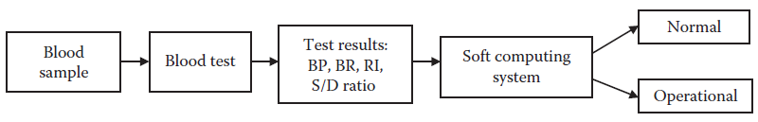
Fetal Delivery
The doctors can also compare their diagnoses with the results computed by these systems and thus cross-verify their results or rather reconsider their decisions in case an anomaly arises in the results of the doctors and those of these systems.
The fetal delivery detection system.

Slide 17
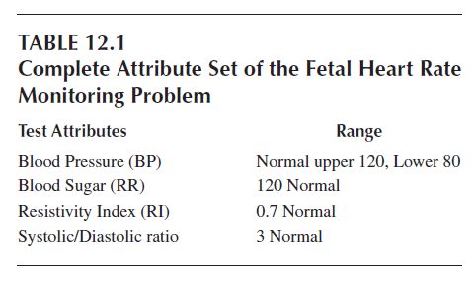
Description of Data Set
The data set for women, pregnancy, and delivery was collected from Pt. Jawaharlal Nehru Government Medical College, Raipur, Chhattisgarh, India. This data is recorded for 640 instances at the time of delivery. This consists of four attributes: blood pressure (BP), blood sugar (BS), resistivity index (RI), and systolic/diastolic ratio (S/D Ratio).

Slide 18
ANN with BPA
The first experiment was with the use of ANN trained with BPA. The ANN consisted of one hidden layer along with input and output layers. There were a total of 50 neurons in the hidden layer. The ANN had a goal of 0.01.
The transfer functions in hidden layer neurons and output layer neurons are sigmoid and purelin respectively. The performance function used was mean sum-squared error (MSE).

Slide 19
RBFN
The second experiment was done with the use of RBFN. The error goal of 0.01 was used. The performance function was MSE. The value of spread was been modified to get an optimized model using RBF. The RBFN had spread value 0.05 and 50 neurons in the hidden layer.
The system gave an accuracy of 99 percent for this problem. The accuracy was same for both the training and testing data.

Slide 20
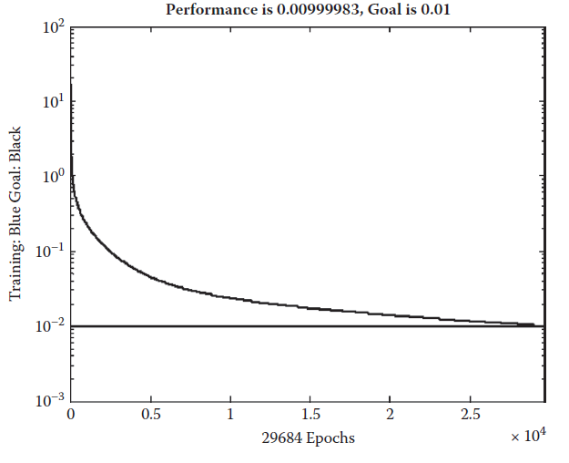
LVQ Networks
LVQ models are simulated for different neurons in hidden layer. The performance function used is MSE. The network used had 50 neurons in the hidden layer. The network attained an accuracy of 7.5 percent for the training data. The performance was 99 percent for the testing data.
Training curve of the artificial neural network for the fetal delivery problem.

Slide 21
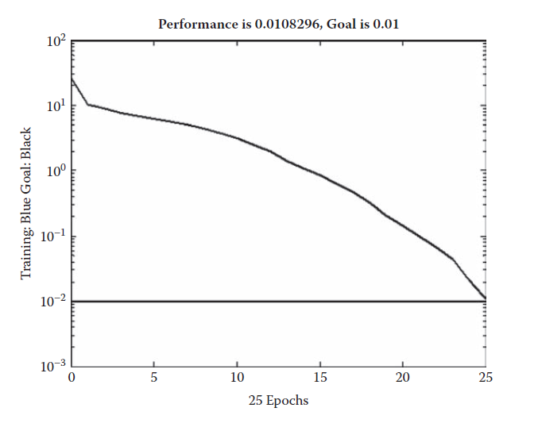
ANFIS
The last system implemented was with the help of ANFIS. For this the MATLAB ANFIS editor was used. Sugeno FIS was used. The membership functions for one of the input variables are shown :
Training curve of the best RBFN model for the fetal delivery problem

Slide 22
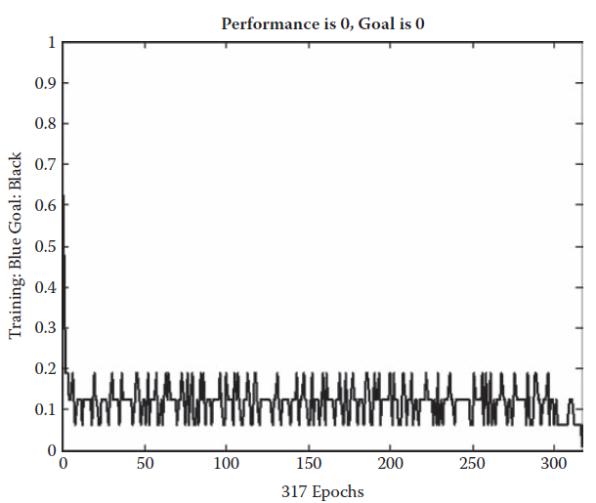
ANFIS
Percentage accuracy of diagnosis for the best training LVQ network for the fetal delivery problem.

Slide 23
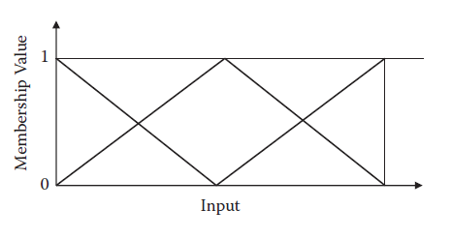
Comparison of results
On the basis of the experimental observations of the previously discussed systems, it is clear that ANFIS gives the highest accuracy, 100 percent, for the diagnosis of fetal delivery system. Further the results obtained in case of RBFN were very high, having an efficiency of 99 percent. In this case ANFIS is the best method to solve the problem.
Input membership functions for the fetal delivery problem.

Slide 24
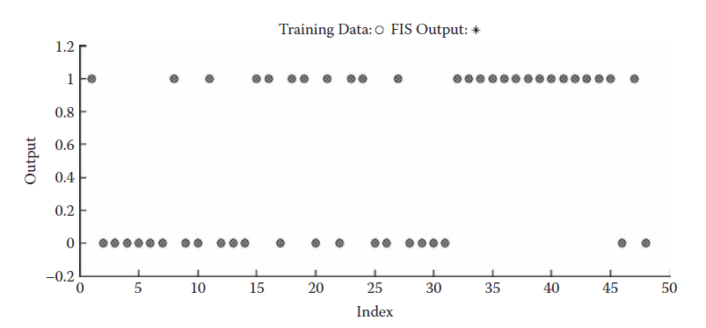
Comparison of results
Outcome of testing the training data sets for the fetal delivery problem.

Slide 25
Pima Indian Diabetes
Here we try to make system that tells us about the presence or the absence of Pima Indian Diabetes by looking at the records of a patient. Diabetes is another problem that calls for great concern.
This requires the development of automated systems that may themselves detect the diabetes in a patient.
Data Set Description
The data set of this problem comes from the UCI Machine Learning repository. The Pima Indian Diabetes data set consists of a total of eight attributes. These decide the presence of diabetes in a person. This database places several constraints on the selection of these instances from a larger database.

Slide 26
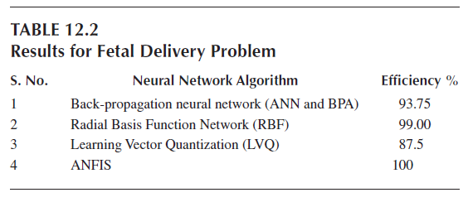
Pima Indian Diabetes
The first attribute is the number of times the women were pregnant. The next attribute is plasma glucose concentration at two hours in an oral glucose tolerance test.
The database contains a total of 768 instances of data; 535 (~70 percent) instances of the data were used for training purposes and the rest 233 (~30 percent) of the data was used for testing purposes.

Slide 27
ANN with BPA
The first method used for this was ANN with BPA. Here we used a single hidden layer, which consisted of 12 neurons. The activation functions for the hidden layer was tansig and purelin. The training function used was traingd. The other parameters were a learning rate of 0.05 and a goal of 10–1. Training was done for 2,000 epochs.
After the network was trained and tested, the performance of the system was found out to be 77.336 percent for the training data set and 77.7358 for the testing data set.

Slide 28
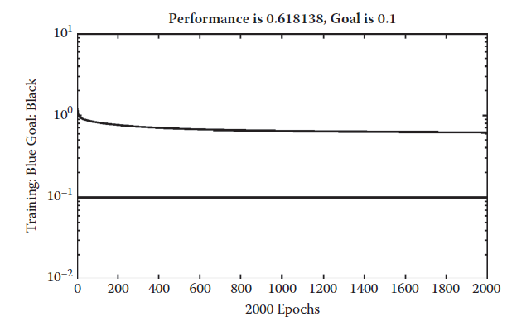
Pima Indian Diabetes
The training curve of artificial neural network for the Pima Indian diabetes problem.

Slide 29
Ensemble
The second experiment was done on ensembles. Here we had used four modules or ANNs. Each one of them was trained separately using the same training data set. The four ANNs were more or less similar with small changes to the ANN used in the preceding section. The first was exactly the same as discussed previously.
The other ANNs only had changes made in the number of neurons in the hidden layer and the number of epochs. These had 14, 10, and 12 neurons respectively. The numbers of epochs were 2,500, 200, and 4,000. The four ANNs were trained separately.
Here we used a probabilistic polling in place of the normal polling. Each module or ANN returned the probability of the input belonging to some class. This means that there are as many outputs as there are classes.

Slide 30
ANFIS
The next experiment was done using ANFIS as a classifier. Here we used the same training as well as testing data sets. The FIS was generated using a grid partitioning method. Each of the attributes had two MFs with it.
The final system so obtained had a performance of 88.9720 percent for the training data and 66.5236 percent for the testing data.

Slide 31
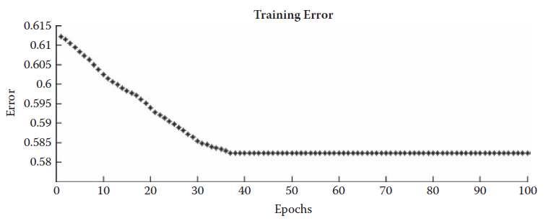
ANFIS
The training curve for ANFIS for the Pima Indian diabetes problem.

Slide 32
Evolutionary ANN
The last hybrid system that was applied to the same problem was the evolutionary ANN. Here we tried to evolve the ANN weights as well as the correct connectionist architecture.
The ANN that we generally take for problem solving in the problems is a fully connected model where every neuron of every layer is connected to all the neuron of the next layer. The same thing, however, does not necessarily exist in the brain, where connections are made and destroyed automatically every second.
In this problem, we first use GA to evolve connectionist architecture. The other role of the GA is to fix the weights of the ANN. We take the maximum complexity that the ANN can span as a single hidden layer model with 25 neurons. Hence the problem is to decide the connections between the input layer and the hidden layer and then the hidden layer and the output layer that are allowed or that exist.

Slide 33
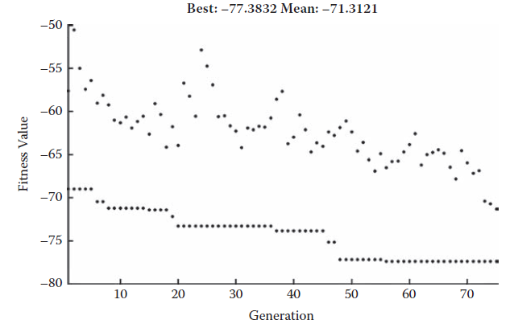
Evolutionary ANN
The training curve for evolutionary artificial neural network for the Pima Indian diabetes problem.

Slide 34
Evolutionary ANN
The first section of the chromosome consists of a 0 or 1, depending upon the existence of connection between the input layer and the hidden layer neurons. A 1 depicts the existence of a connection, and a 0 depicts an absence of a connection. Similarly the next section depicts the existence of a weight between a hidden layer neuron and an output layer neuron. The bits have their same meaning.
The crossover and mutation were modified to match the requirement of the problem. The crossover used was a two-point crossover, which was applied in such a way that the first point always lay in the sections that constitute the architecture and consisted of the bits.
The other parameters of the GA were 25 as the population size with an elite count of 2. The creation function was uniform, and double vector representation was chosen.
The final system had a performance of 77.38 percent for the training data set and 73.819 percent in the testing data set.

Slide 35
Conclusion Remarks for Pima Indian Diabetes
We saw that the ANN was able to solve the problem appreciably well, and hence we got a good recognition that was capable of solving the problem.
The next method discussed was the ANFIS. Here we observed that the system was able to give a good performance. The results reveal that the system performed very well on the training data set but did not do that well on the testing data set.
We discussed the evolutionary ANNs. These systems also gave a good performance where they could decide their own architecture as well as the values for the weights and biases. We saw a good performance of these systems in the presented problem.

Slide 36
Fetal Heart Sound De-NoisingTechniques
Fetal heart rate (FHR) monitoring refers to the monitoring of the heart rate of the fetus. This enables doctors to analyze the activity and hence the health of the child in the womb of a pregnant women. This further helps in querying the health of the child from time to time so that measures may be taken at the early stage of any health hazard.
Numerous techniques are actively used for the FHR. One commonly used technique is ultrasound Doppler-based cardiotocography (CTG).
Fetal electrocardiography (FECG) is another tool that is used monitoring. This uses electrodes on the maternal abdominal surface. However, the signal processing requirement is very complex in these cases.
In this section we first present the signal detection and recording techniques

Slide 37
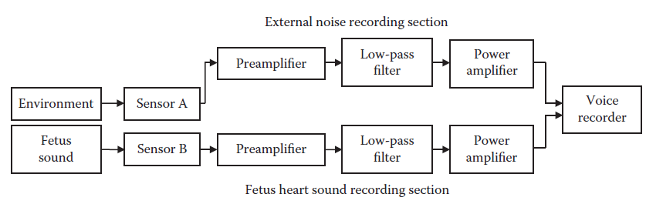
Fetal Heart Sound De-NoisingTechniques
Block diagram of DRM module.

Slide 38
Signal Detection and Recording
The basic motive of this problem is to remove the ambient noise that creates a lot of problems at the time of signal processing. In order to remove noise, we develop specialized techniques that require recording of the noise that is present in the signals.
The two sensors record their signals, which go to separate preamplifiers. This amplifies the signals and makes them capable of better noise rejection. The IC LM 381 is used here for this particular purpose, which raises the signal from the transducer level to the line level.
The ambient noise is controlled with the help of an active low-pass filter having a cutoff frequency of 70 Hz. This value of cutoff frequency is selected because most of the fetal heart sound spectrum lies within the frequency range of 20 to 70 Hz.
The output that the filter generates is further strengthened with the help of a power amplifier. This gives us the de-noised fetal heart sound.

Slide 39
Signal De-Noising
The first, or the sensor ‘A’, records only the noise and is placed at a region near the abdomen to record nearly the kind of sound that would be present at the abdomen.
The second sensor, or the sensor ‘B’, is placed very near to the abdomen to record the fetal heart rate. This fetal heart rate gets mixed with damped version of the external noise when it is recorded. This noise badly affects the original signal, which drastically changes from one beat to next.
The signal-to-noise ratio (SNR) hence becomes very poor. These unwanted, disturbing signals contribute to difficulty in identification of the principal heart sounds (S1 and S2).

Slide 40
Band-Pass Filtering Method
This method only carries forwards the signals that lie within a comfortable range of 40 Hz < f < 80 Hz. All the other frequencies are deleted.
The selection of the lower limit is based on the experimental fact that a significant part of the maternal heart and digestive sound lies below this border, while the fetal heart sounds are not dominantly present there anymore.

Slide 41
Signal Difference Method
We recorded the signals from two sensors, A and B, that recorded the noise and the noisy signal. Here we make use of both of these to calculate the final system output.
The external channel amplitude is adjusted and then filtered through a low-pass filter to accommodate the effect of sound insulation medium transfer characteristics, which are around the abdominal microphone.
Subsequently, the filtered external noise signals are subtracted from the signals of the abdominal channel.

Slide 42
Blind Separation of Source Method
Blind source separation (BSS) refers to the problem of recovering signals from several observed linear mixtures.
The strength of the BSS model is that only mutual statistical independence between the source signals is assumed and no prior information about the characteristics of the source signals, the mixing matrix, or the arrangement of the sensors is needed.
The cancellation of external noise from abdominal signals can be stated as a two source, two-drain problem for BSS analysis.

Slide 43
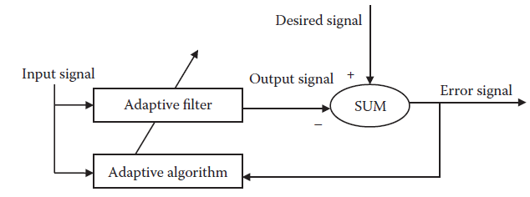
Adaptive Noise Cancellation Method
This is a very innovative technique of removal of the noise from the signal that uses an adaptive architecture for the purpose of the removal of the noise based on the noise in the background and the recorded fetal phonographic signal.
General adaptive filter

Slide 44
Adaptive Noise Cancellation Method
Adaptive filters calculate the noise that is most probably in the system and hence separate the noise from the rest of the signal.
The goal is to make the output almost the same as the original signal not containing any instances of noise. The filter coefficients are changed for these purposes. Alternatively, it is possible to say that adaptive filter coefficients or weight changes over time to adapt the statistics of the signal.
The system that we develop here takes as its input both the recorded signal of the fetal heart as well as the sample noise. As the noise on the input port remains correlated to the noise on the desired port, the adaptive filter adjusts its coefficients.
This filter is used for removal of noise that gets mixed with the genuine signal of the fetal heart.

Slide 45
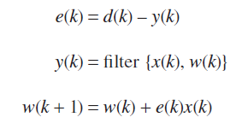
Adaptive Noise Cancellation Method
The generalized mathematical relations between desired signal d(k), input signal x(k), output signal y(k), error signal e(k), and filter weight w(k) are given by Equations :
Signal d(k), which is to be cleaned, is applied on the desired port. It comes from the abdominal microphone, which contains the noise n(k) and the desired signal s(k). The external microphone carries only background noise n2(k) and is applied as the input signal x(k) to the filter.

Slide 46
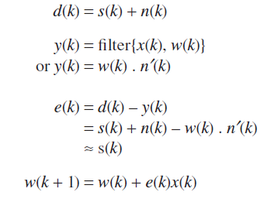
Adaptive Noise Cancellation Method
As long as the input noise to the filter n2(k) remains correlated to the unwanted noise n(k), the adaptive filter adjusts its weights w(k), reducing the difference between y(k) and d(k). This results in removal of the external noise, and the de-noised fetal heart signal s(k) will appear on the error port.

Slide 47
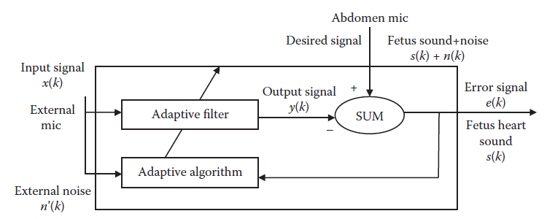
Adaptive Noise Cancellation Method
Adaptive filter used for de-noising.

Slide 48
Adaptive Noise Cancellation Method
It is important to note that in this implementation, the error signal converges to the input data signal, rather than converging to zero.

Slide 49
System Simulation
Various algorithms have been simulated in order to study the effect of adaptive filtering. Algorithms took as their input the fetal heart sound signals of widely distinctive nature and quality. MATLAB Simulink is used to model and simulate these algorithms, which are then analyzed for their output performance in the time and frequency domain.
The fetal heart sound signal detected from the mother’s abdomen is fetched from the corresponding *.wav file and applied to the desired port of the filter block. This signal carries the fetal heart sound and a damped version of the external noise.
The unwanted external noise is available in another *.wav file and is applied to the input port of the filter. The de-noised signal comes out through the error port, which is connected to the time scope block, where original signals and denoised signals are displayed and compared.

Slide 50
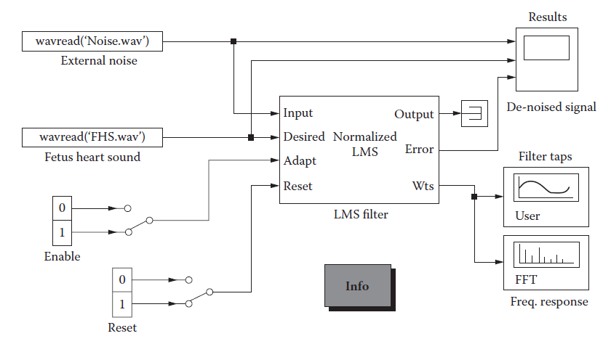
System Simulation
Computer simulation for adaptive noise cancellation.

Slide 51
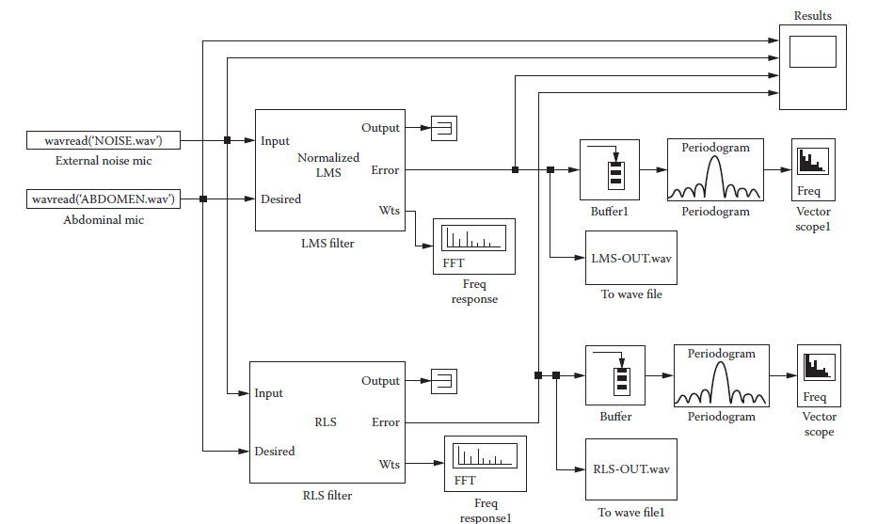
System Simulation
Computer simulation for comparative analysis between two adaptive filters.

Slide 52
Results
A prototype of the phonocardiography recording device designed and developed has been used for fetal heart sound and external noise recording. More than 20 fetal heart sound recordings were taken from different women, who were between 36th and 40th week of singleton pregnancy.
Recorded data were transferred to a personal computer as *.wav files through a multimedia card. The MATLAB simulation considered previously was used to process and display the recorded sound from the wave files.
X-axis represents the time in seconds and the Y-axis represents the amplitude of the signal in volts.

Slide 53
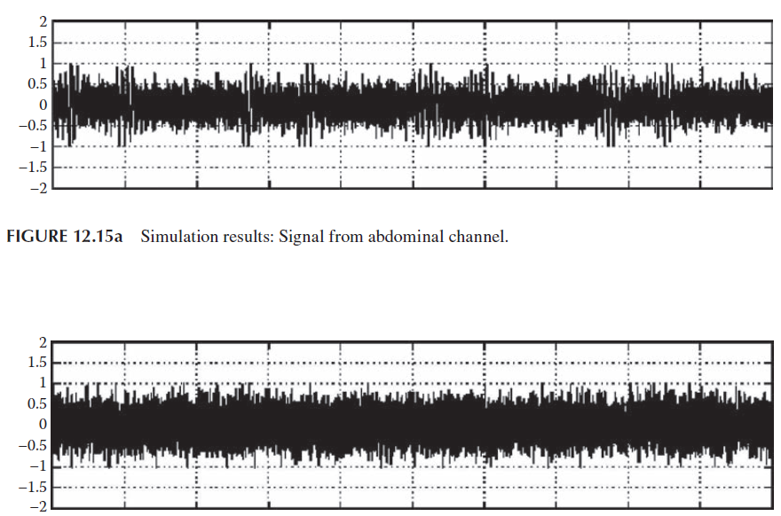
Results
FIGURE 12.15b Simulation results: Signal of external channel.

Slide 54
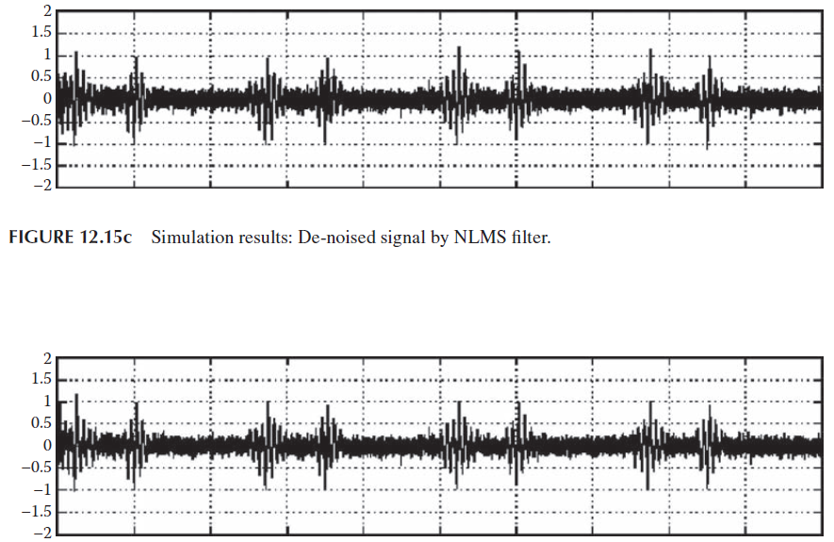
Results
FIGURE 12.15d Simulation results: De-noised signal by RLS filter

Slide 55
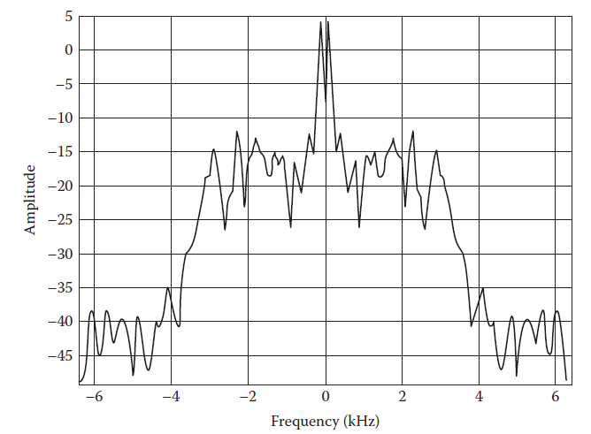
Results
Frequency spectrum of signal from NLMS.

Slide 56
Results
It can be clearly deduced that the fetal heart sound is meticulously extracted from the abdominal signal and the signal-to-noise ratio is considerably increased by the use of these methods. Although the output of two algorithms looks very similar, making detailed close observations one can see the minute differences and it can be deduced that the RLS algorithm performs better than the normalized LMS algorithm.
Along with time domain response, the simulation also shows the frequency spectrum of the filter’s output signals. The spectral display for fetal heart sounds around the 0.55 s instant of recorded signal is shown in Figure :

Slide 57
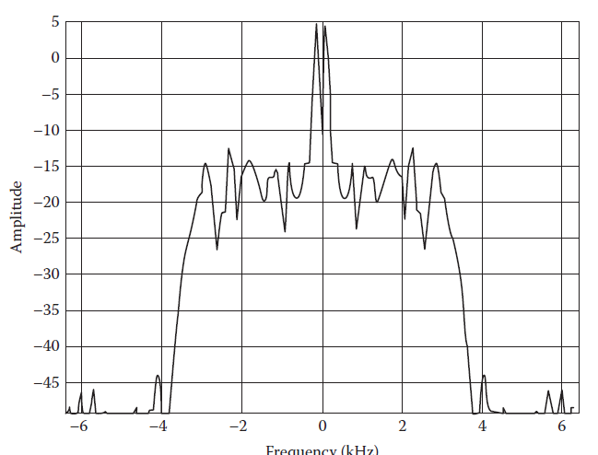
Results
Frequency spectrum of signal from RLS adaptive filters.

Slide 58
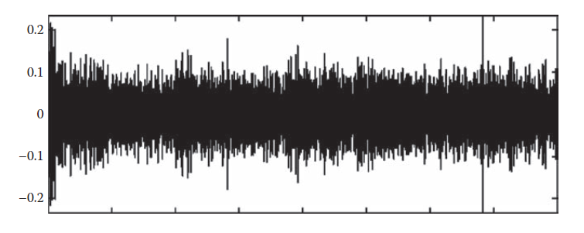
Results
Detail signal component of NLMS.

Slide 59
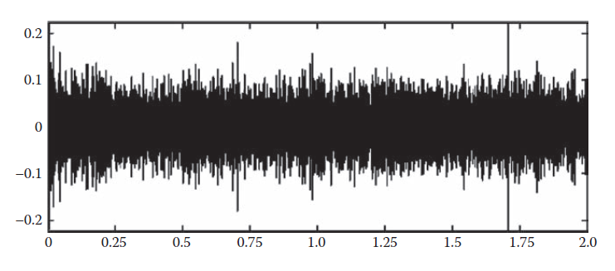
Results
Detail signal component of RLS adaptive filters

Slide 60
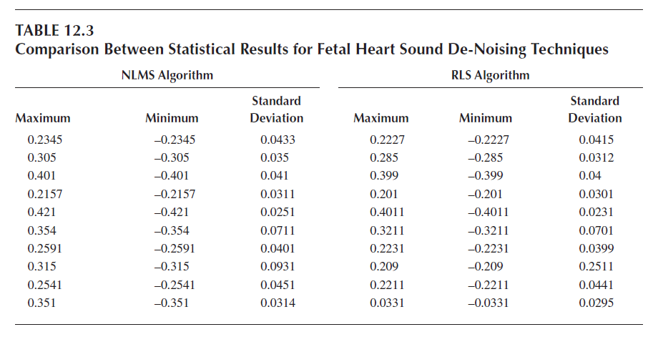
Results

Slide 61
Concluding Remarks for Fetal Heart Sound De-Noising Techniques
Cardiography and Cardiotocography are the most commonly used noninvasive clinical diagnostic tools that provide accurate determination of FHR.
These devices have a few inherent limitations due to the use of ultrasound. To overcome this, an alternative technique, phonocardiography, was used in which acoustic vibrations produced by mechanical activity of heart are detected. This technique is fully passive and therefore provides absolutely noninvasive fetal diagnostic measurement.
A portable lead-free fetal heart sound recording system was designed and developed, which can be used for nonstress tests and for long-time monitoring of fetal heart sounds in high-risk pregnancies.

